Slide 1



Hibernate One-to-Many Uni-Directional

Slide 2



One-to-Many Mapping
A course can have many reviews
Uni-directional
Review
Review
Course
Review
Review
www.luv2code.com

Slide 3




Real-World Project Requirement
If you delete a course, also delete the reviews
Reviews without a course … have no meaning
Review
Apply cascading deletes!
Review
Course
Review
Review
www.luv2code.com

Slide 4

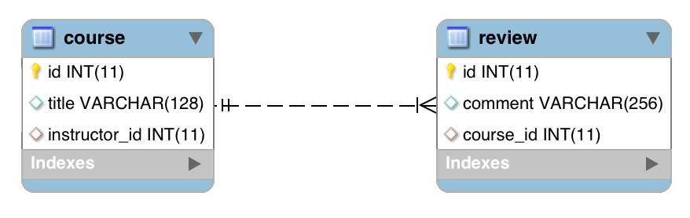
@OneToMany
@OneToMany (uni)
www.luv2code.com

Slide 5

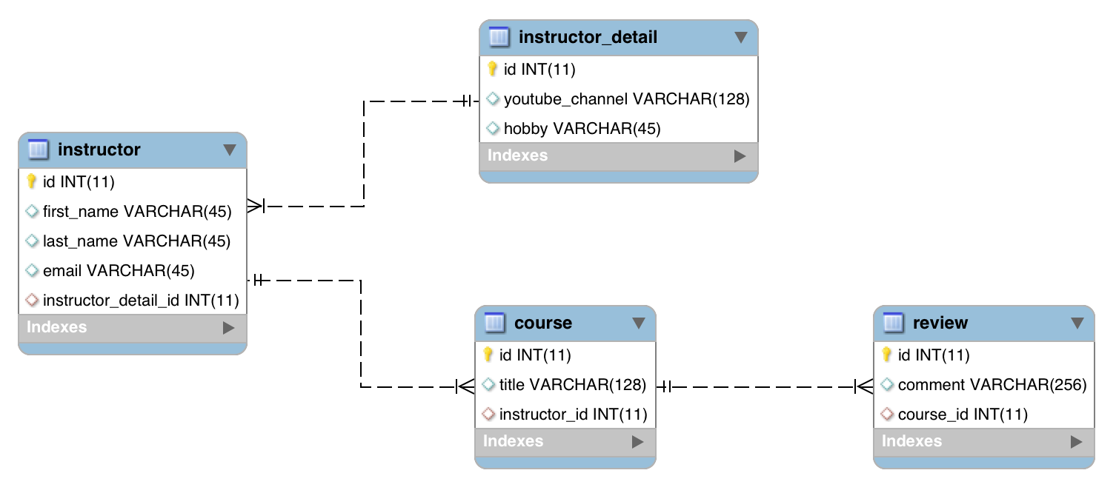

Look Mom … our project is growing!
@OneToOne
This section is new!
@OneToMany (bi)
@OneToMany (uni)
@ManyToOne
www.luv2code.com

Slide 6
Development Process: One-to-Many
Step-By-Step
Prep Work - Define database tables
Create Review class
Update Course class
Create Main App
www.luv2code.com

Slide 7



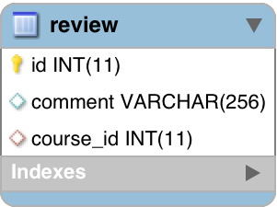
table: review
File: create-db.sql
comment:
“Wow … this course is awesome!”
CREATE TABLE `review` (
`id` int(11) NOT NULL AUTO_INCREMENT,
`comment` varchar(256) DEFAULT NULL,
`course_id` int(11) DEFAULT NULL,
...
);
www.luv2code.com

Slide 8


table: review - foreign key
File: create-db.sql
CREATE TABLE `review` (
…
KEY `FK_COURSE_ID_idx` (`course_id`),
CONSTRAINT `FK_COURSE`
FOREIGN KEY (`course_id`)
REFERENCES `course` (`id`)
…
);
Table
Column
www.luv2code.com

Slide 9

table: course - no changes
www.luv2code.com

Slide 10



Step 2: Create Review class
@Entity @Table(name="review") public class Review {
@Id @GeneratedValue(strategy=GenerationType.IDENTITY) @Column(name="id")
private int id;
@Column(name="comment") private String comment;
…
// constructors, getters / setters
}
www.luv2code.com

Slide 11


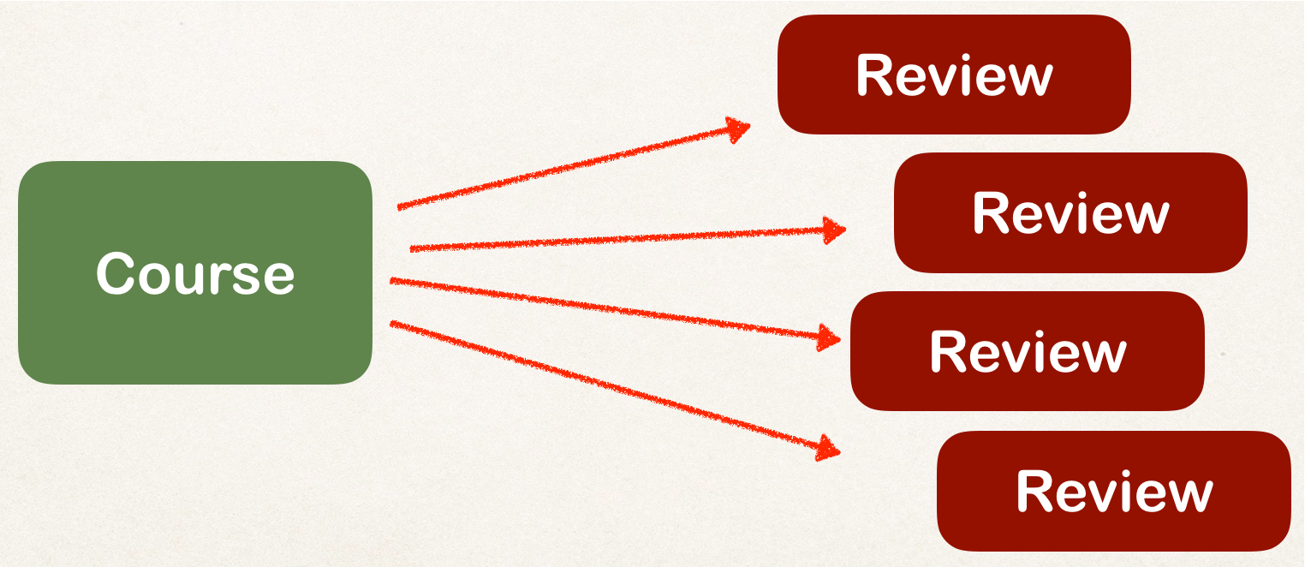
Step 3: Update Course - reference reviews
@Entity @Table(name="course") public class Course {
…
private List<Review> reviews;
// getter / setters
…
}
www.luv2code.com

Slide 12

Add @OneToMany annotation
@Entity @Table(name="course") public class Course {
…
@OneToMany @JoinColumn(name="course_id") private List<Review> reviews;
// getter / setters
…
}
Refers to “course_id” column in “review” table
www.luv2code.com

Slide 13


More: @JoinColumn
public class Course {
…
@OneToMany @JoinColumn(name="course_id") private List<Review> reviews;
•
In this scenario, @JoinColumn tells Hibernate
•
Look at the course_id column in the review table
•
Use this information to help find associated reviews for a course
www.luv2code.com

Slide 14


Add support for Cascading
Cascade all operations including deletes!
@Entity @Table(name="course") public class Course {
…
@OneToMany(cascade=CascadeType.ALL) @JoinColumn(name="course_id")
private List<Review> reviews;
…
}
www.luv2code.com

Slide 15

Add support for Lazy loading
Lazy load the
@Entity @Table(name="course") public class Course {
…
reviews
@OneToMany(fetch=FetchType.LAZY, cascade=CascadeType.ALL) @JoinColumn(name="course_id")
private List<Review> reviews;
…
}
www.luv2code.com

Slide 16

Add convenience method for adding review
@Entity @Table(name="course") public class Course {
…
// add convenience methods for adding reviews
public void add(Review tempReview) { if (reviews == null) {
reviews = new ArrayList<>();
}
reviews.add(tempReview);
}
…
}
www.luv2code.com

Slide 17



Step 4: Create Main App
public static void main(String[] args) {
…
// get the course object
int theId = 10;
Course tempCourse = session.get(Course.class, theId);
Lazy load the reviews
// print the course
System.out.println("tempCourse: " + tempCourse);
// print the associated reviews
System.out.println("reviews: " + tempCourse.getReviews());
…
}
www.luv2code.com

